Slide 1
Simply Blogging
Phase End Project

Slide 2
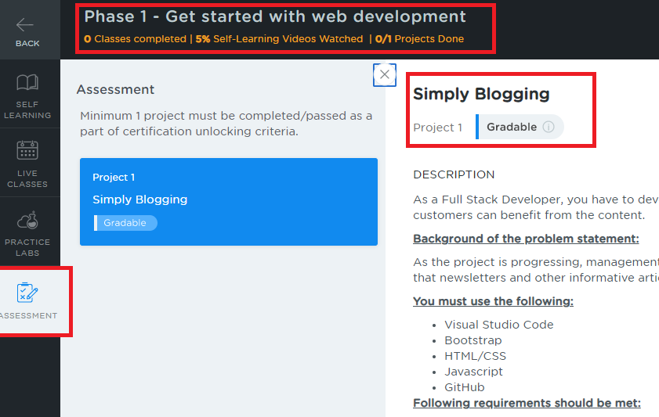
Project Description Location
Login to LMS & go to Program - Full Stack Web Developer – MEAR Stack
Under Course 2, Choose Phase 1 – Get Started with web development
You will see Assessment towards the left side as below

Slide 3
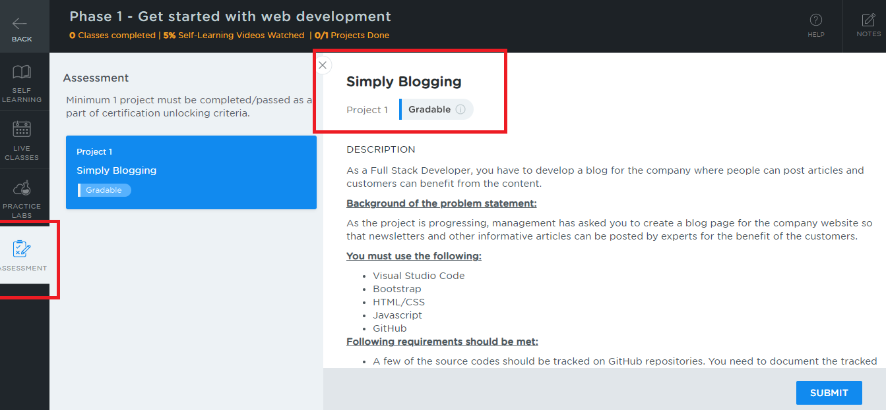
Project Description Location
Click on the assessment to view the project description, read the complete description in the LMS

Slide 4
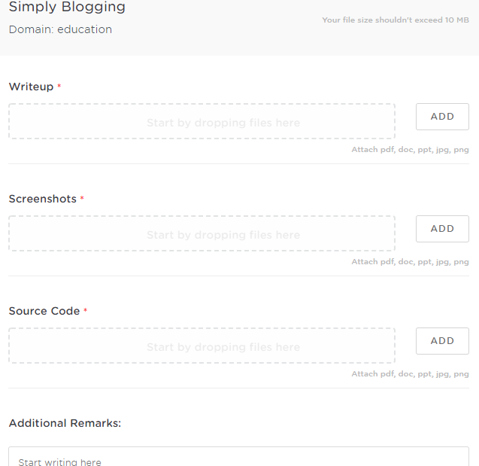
Project Submission Steps
After you click on submit you will get a window as below

Slide 5
Important things to consider
Write Up
Don’t push the document into the Git repository, use .gitignore file
Better create separate folder for the project inside the git repository
Mention the Git repo link in the document
Mention the folder name that has project in the document
Give brief information about the source code files to make us understand what is the file purpose in the document.
EX: index.html is the main page which has links to Home, Services, Contacts
EX: styles.css is the style sheet that is used to design web page
EX: myscripts.js is the javascript code which has functions like search() to search the data

Slide 6
Important things to consider
Screenshot
Add the output screen shot of the project
You are allowed to add multiple screen shots in case required
Source Code
Wrap all the source codes like html, css, js, ts, etc in a zip
Upload the zip
If in case zip is not supported you can attach all source codes one by one
Note:
While pushing the project in Git repository you can have all your assignments and projects in a single repository
Create separate folders for each project in the Git repository, however you can mention these folder names in the document

Slide 7
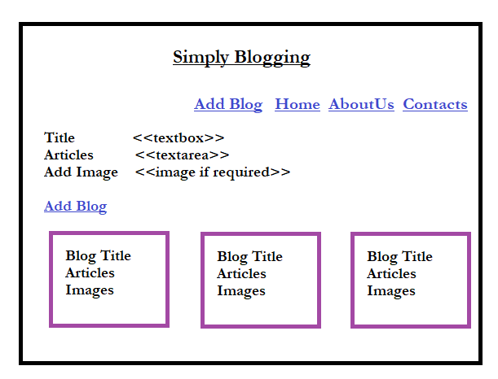
Project Implementation

Slide 8
Technology to be used
HTML
Javascript
CSS
Bootstrap JS
Note: Use any blog templates as a reference to create the web page so that it will have a very good look and feel, ex: Bootstrap simple blog

Slide 9
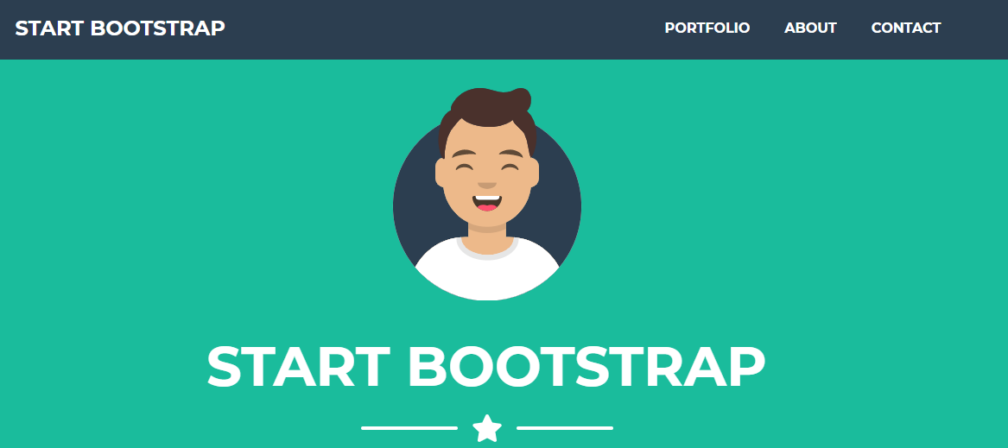
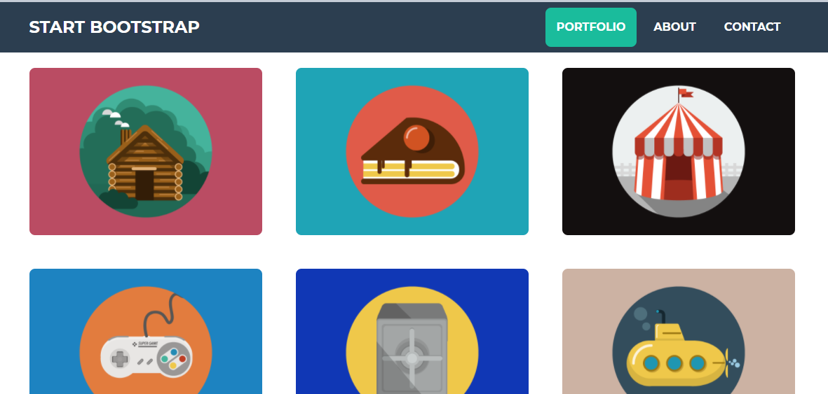
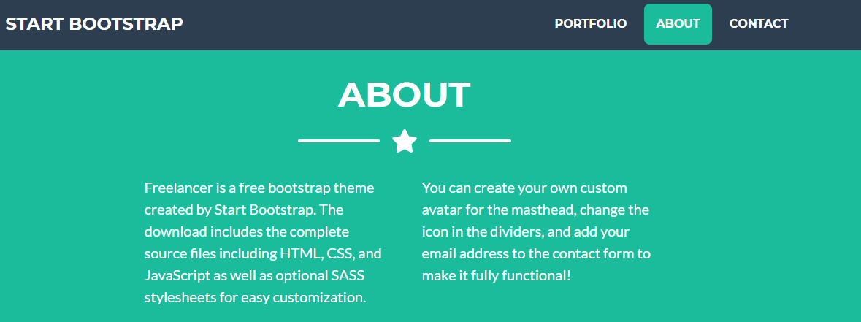
Sample Templates for reference

